Slide 1
The Perfect Analyst
Team: 0506_10
Members: Madathil Geetanjali Menon, Sri Sai Alekya Ghanta, Aishwarya Sadagopan, Nishanthi Ravichandran
Presentation Date: December 7, 2022
Data Oriented Jobs Analysis

Slide 2





Meet the Team
Madathil Geetanjali Menon
Sri Sai Alekya Ghanta
Aishwarya Sadagopan
Nishanthi Ravichandran

Slide 3

Background

Slide 4

Project Goals
Address common queries of Masters' students seeking full-time job opportunities in the Data Oriented / Analyst job functions across the United States, via Indeed.com
End Users
Graduate Students, Organizations’ Talent Acquisition Team are our target users

Slide 5
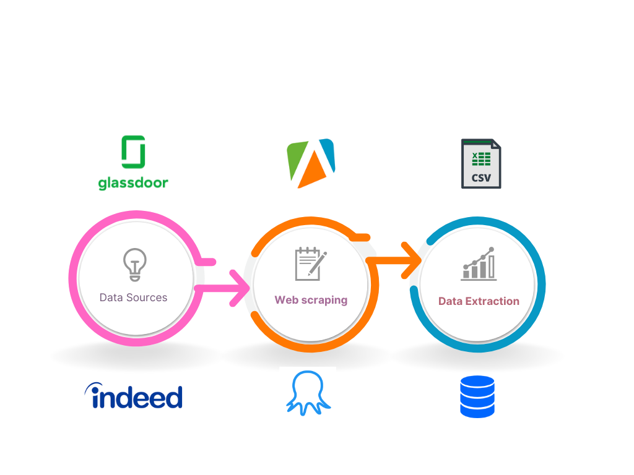
Data and Sources

Slide 6
Introduction

Slide 7
Mission Objectives
Job Seeker’s point of view
Company’s point of view
Understand reviews by current employees and leverage them for the company’s development
Identify top candidates for open positions, based on the required skills
Top companies offering high salaries within each job function
Identify top skills required for each of the data oriented roles
Identify best-rated firms as per the reviews from Glassdoor and Indeed
Determine companies offering remote vs onsite opportunities
Companies with openings in more than one job function
To identify job seeker’s profile match rate with different jobs

Slide 8

Conceptual Database Design

Slide 9

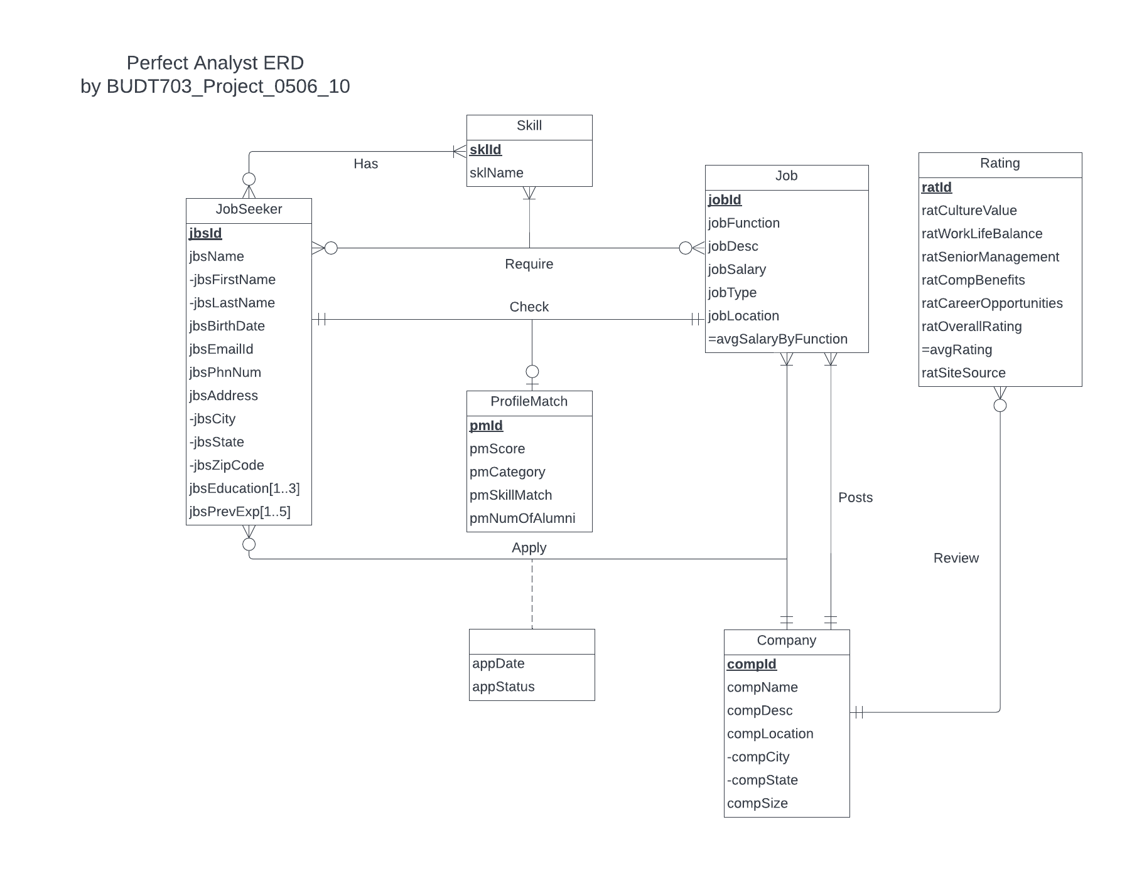
ER Diagram
Entities
JobSeeker
Job
Company
Skill
Rating
Profile Match

Slide 10

Logical Database Design

Slide 11

Relational Schema
JobSeeker (jbsId, jbsFirstName, jbsLastName, jbsBirthDate, jbsEmailId, jbsPhnNum, jbsCity, jbsState, jbsZipCode)
Job Seeker Education (jbsId, jbsEducation)
Job Seeker Previous Experience (jbsId, jbsPrevExperience)
Company (compId, compName, compDesc, compCity, compState, compSize)
Job (jobId, jobFunction, jobDesc, jobSalary, jobType, jobLocation, compId)
Rating (ratId, ratCultureValue, ratWorkLifeBalance, ratSeniorManagement, ratCompBenefits, ratCareerOpportunities, ratOverallRating, ratSiteSource,compId)

Slide 12
Relational Schema
Skill (sklId, sklName)
ProfileMatch (pmId, pmScore, pmCategory, pmSkillMatch, pmNumOfAlumni)
Has (jbsId, sklId)
Require (jbsId, jobId, sklId)
Check (pmId, jbsId, jobId)
Apply (jbsId, jobId, compId, appDate, appStatus)

Slide 13

Physical Database Design

Slide 14

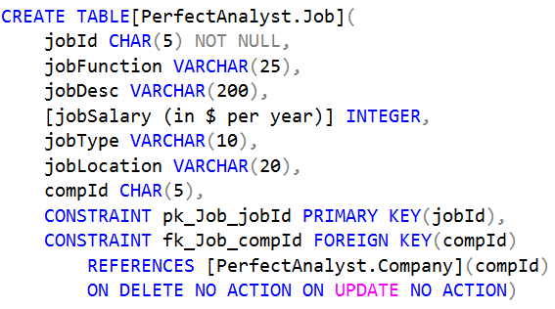
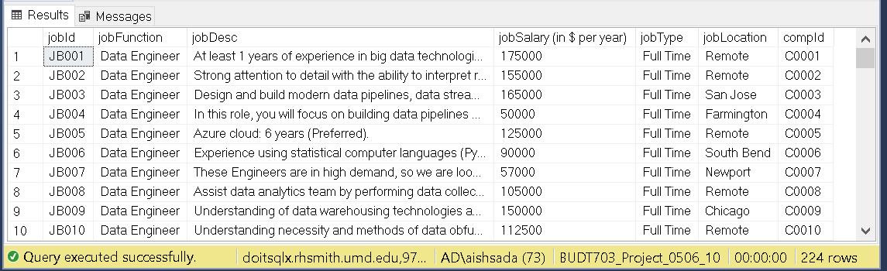
Create Table

Slide 15

Use Cases

Slide 16
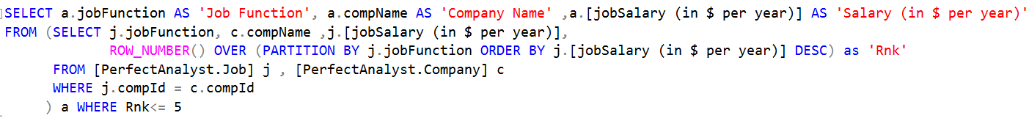
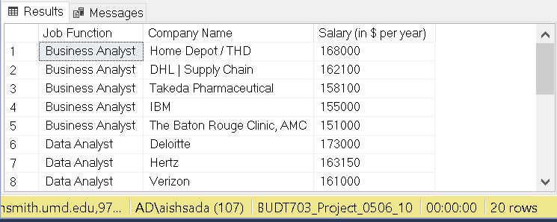
What are the top 5 companies by salary within each job function?

Slide 17
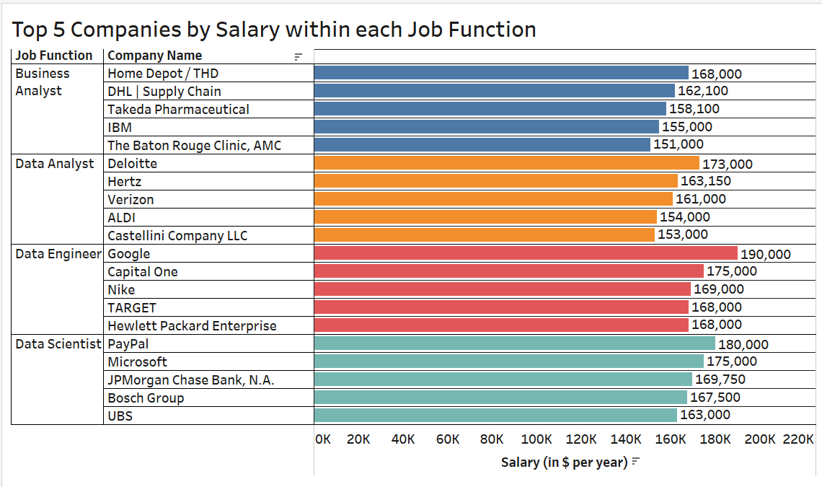
What are the top 5 companies by salary within each job function?

Slide 18
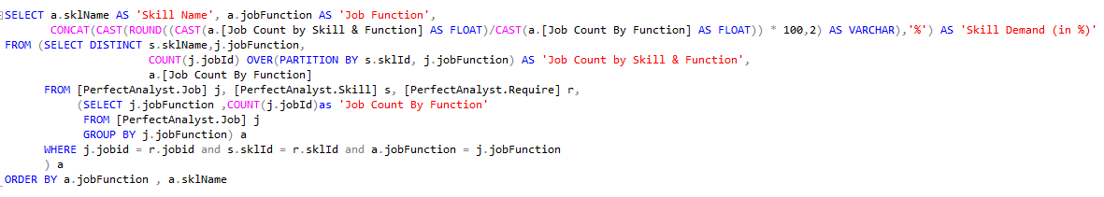
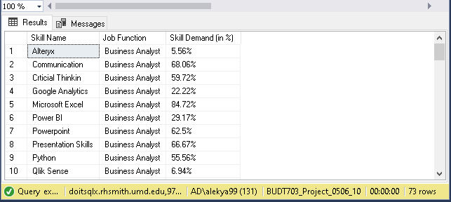
What are the percentage of different skills required in each job function?

Slide 19
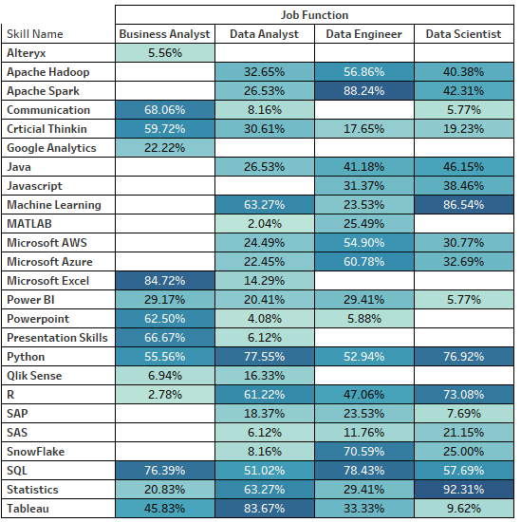
What are the percentage of different skills required in each job function? - Visualized

Slide 20

Thanks!
Any questions?

